Slide 1
CSE 12 – Basic Data Structures and Object-Oriented Design Lecture 11
Greg Miranda & Paul Cao, Winter 2021
This lecture is being recorded

Slide 2
Announcements
Quiz 11 due Wednesday @ 8am
Survey 5 due Friday @ 11:59pm
PA4 due Wednesday @ 11:59pm

Slide 3
Topics
Questions on Lecture 11?
Big Theta
Sorting

Slide 4
Questions on Lecture 11?

Slide 5
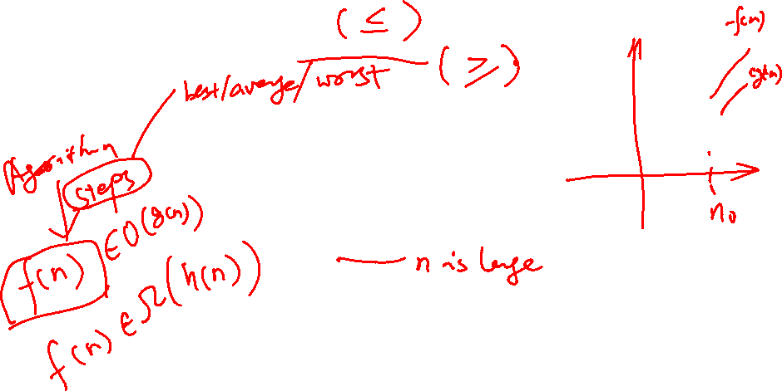
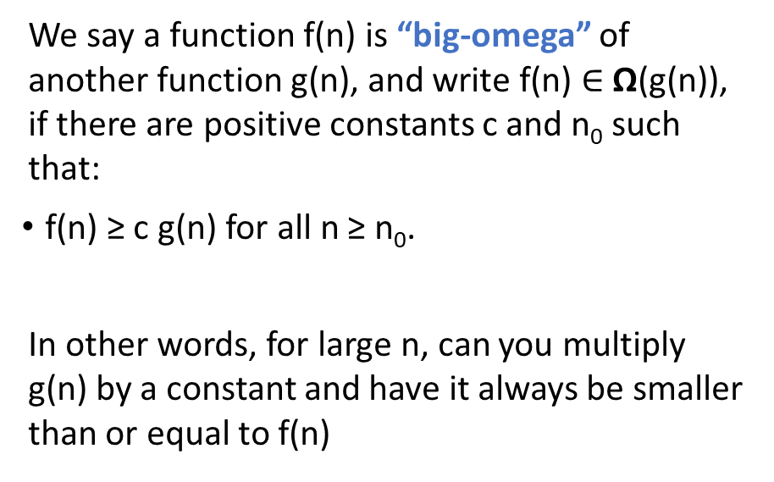
O is an upper bound Ω is a lower bound
We say a function f(n) is “big-omega” of another function g(n), and write f(n) $∈$ Ω(g(n)), if there are positive constants c and n₀ such that:
f(n) ≥ c g(n) for all n ≥ n₀.
In other words, for large n, can you multiply g(n) by a constant and have it always be smaller than or equal to f(n)

Slide 6
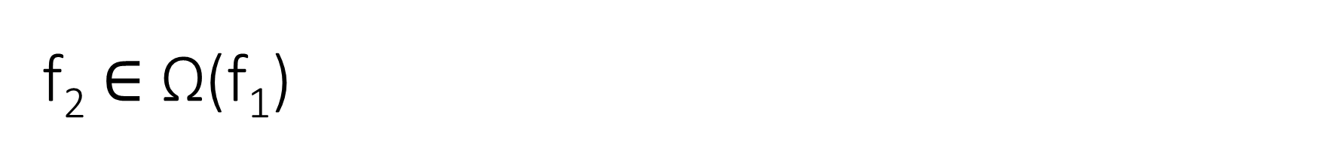
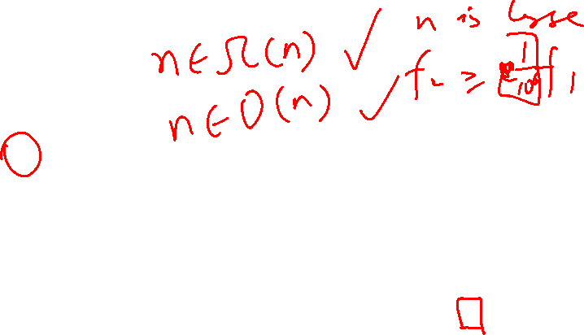
f₂ $∈$ Ω(f₁)
TRUE
FALSE
Why or why not?
f₁
f₂
In other words, for large n, can you multiply f₁ by a positive constant and have it always be smaller than f₂

Slide 7
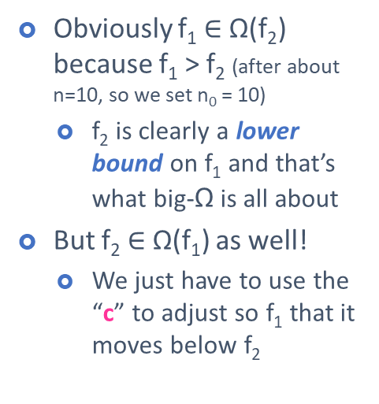

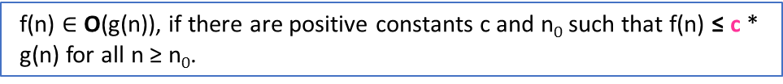
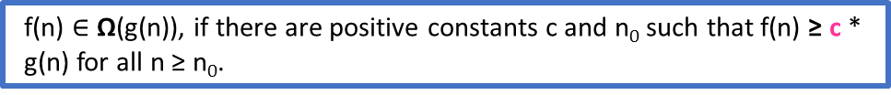
f(n) $∈$ O(g(n)), if there are positive constants c and n₀ such that f(n) ≤ c * g(n) for all n ≥ n₀.
f(n) $∈$ Ω(g(n)), if there are positive constants c and n₀ such that f(n) ≥ c * g(n) for all n ≥ n₀.
Obviously f₁ $∈$ Ω(f₂) because f₁ > f₂ (after about n=10, so we set n₀ = 10)
f₂ is clearly a lower bound on f₁ and that’s what big-Ω is all about
But f₂ $∈$ Ω(f₁) as well!
We just have to use the “c” to adjust so f₁ that it moves below f₂
f₁
f₂
c * f₁

Slide 8
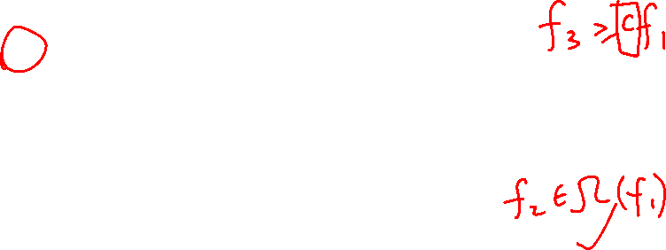
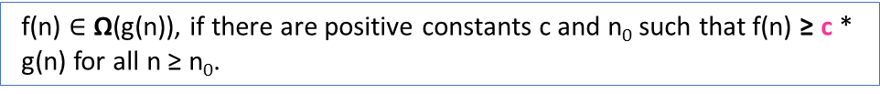
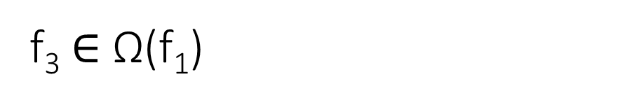
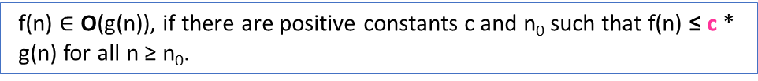
f₃ $∈$ Ω(f₁)
f(n) $∈$ O(g(n)), if there are positive constants c and n₀ such that f(n) ≤ c * g(n) for all n ≥ n₀.
f(n) $∈$ Ω(g(n)), if there are positive constants c and n₀ such that f(n) ≥ c * g(n) for all n ≥ n₀.
f₃
TRUE
FALSE
Why or why not?
f₁
f₂

Slide 9
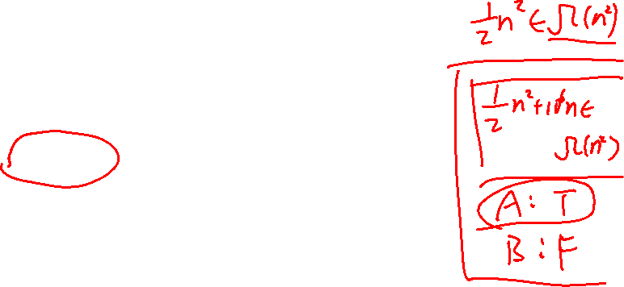
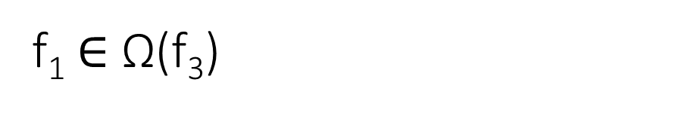
f₁ $∈$ Ω(f₃)
f(n) $∈$ O(g(n)), if there are positive constants c and n₀ such that f(n) ≤ c * g(n) for all n ≥ n₀.
f(n) $∈$ Ω(g(n)), if there are positive constants c and n₀ such that f(n) ≥ c * g(n) for all n ≥ n₀.
f₃
TRUE
FALSE
Why or why not?
f₁
f₂

Slide 10
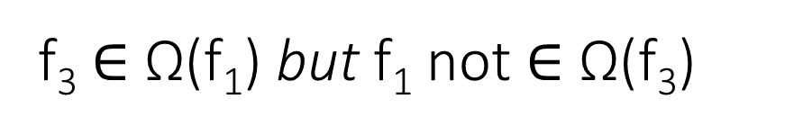
f₃ $∈$ Ω(f₁) but f₁ not $∈$ Ω(f₃)
There is no way to pick a c that would make an O(n²) function (f₃) stay below an O(n) function (f₁).
f₃
f₁

Slide 11
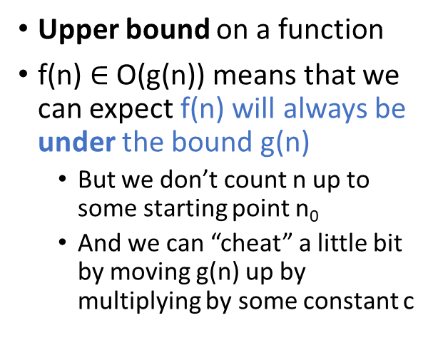
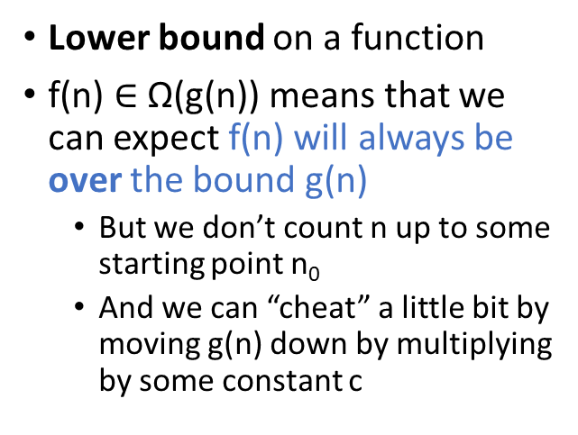
Summary
Big-O
Big-Ω
Upper bound on a function
f(n) $∈$ O(g(n)) means that we can expect f(n) will always be under the bound g(n)
But we don’t count n up to some starting point n₀
And we can “cheat” a little bit by moving g(n) up by multiplying by some constant c
Lower bound on a function
f(n) $∈$ Ω(g(n)) means that we can expect f(n) will always be over the bound g(n)
But we don’t count n up to some starting point n₀
And we can “cheat” a little bit by moving g(n) down by multiplying by some constant c

Slide 12
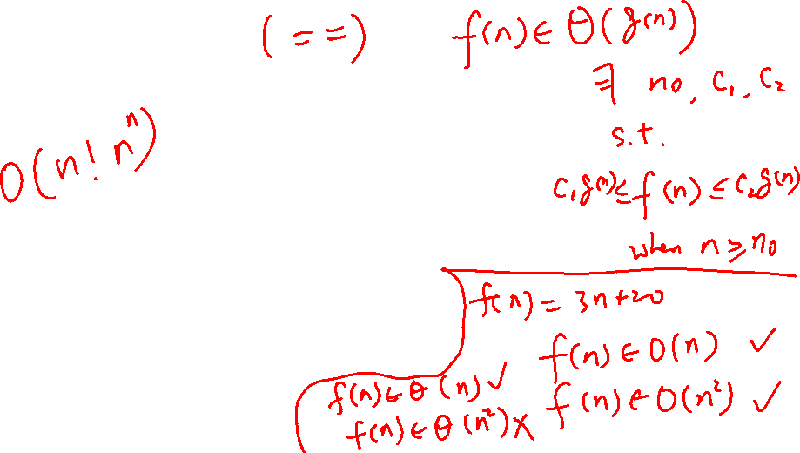
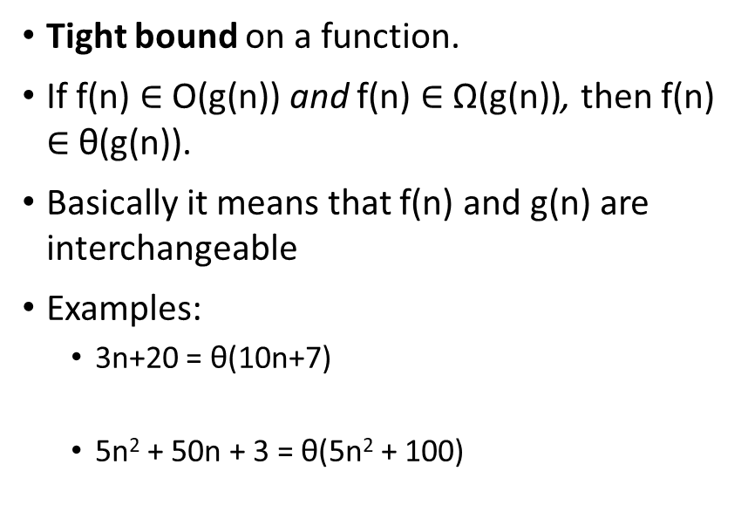
Big-θ
Tight bound on a function.
If f(n) $∈$ O(g(n)) and f(n) $∈$ Ω(g(n)), then f(n) $∈$ θ(g(n)).
Basically it means that f(n) and g(n) are interchangeable
Examples:
3n+20 = θ(10n+7)
5n² + 50n + 3 = θ(5n² + 100)

Slide 13
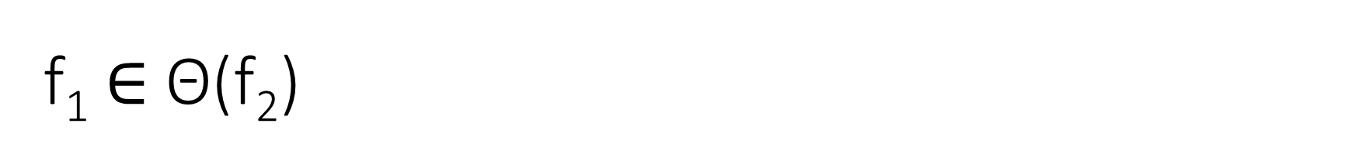

f₁ $∈$ Θ(f₂)
TRUE
FALSE
Why or why not?
f₁
f₂

Slide 14
f₁ $∈$ Θ(f₂)
TRUE
FALSE
Why or why not?
Since f₁ is O(f₂) and Ω(f₂), it is also Θ(f₂) (this is the definition of big-Theta)
f₁
f₂

Slide 15
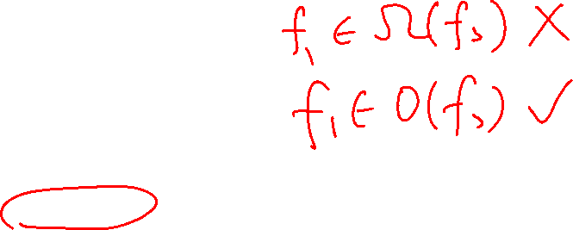
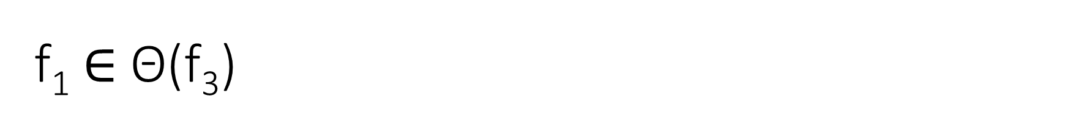
f₁ $∈$ Θ(f₃)
TRUE
FALSE
Why or why not?
f₃
f₁
f₂

Slide 16
Big-θ and sloppy usage
Sometimes people say, “This algorithm is O(n²)” when it would be more precise to say that it is θ(n²)
They are intending to give a tight bound, but use the looser “big-O” term instead of the “big-θ” term that actually means tight bound
Not wrong, but not as precise
I don’t know why, this is just a cultural thing you will encounter among computer scientists

Slide 17
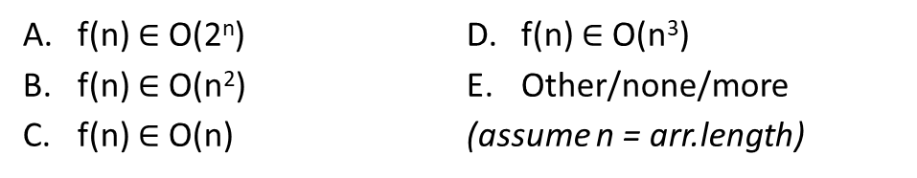
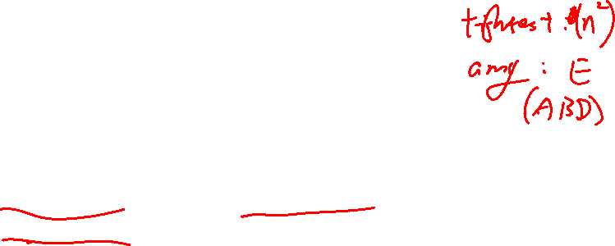
Count how many times each line executes, then say which O( ) statement(s) is(are) true.
Line #
int maxDifference(int[] arr){
max = 0;
for (int i=0; i<arr.length; i++) {
for (int j=0; j<arr.length; j++) {
if (arr[i] – arr[j] > max)
max = arr[i] – arr[j];
}
}
return max;
}
1
2
3
4
5
6
7
8
9
f(n) $∈$ O(2^{n})
f(n) $∈$ O(n²)
f(n) $∈$ O(n)
f(n) $∈$ O(n³)
Other/none/more
(assume n = arr.length)

Slide 18
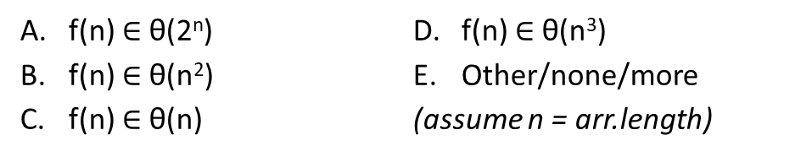

Count how many times each line executes, then say which Θ( ) statement(s) is(are) true.
Line #
int maxDifference(int[] arr){
max = 0;
for (int i=0; i<arr.length; i++) {
for (int j=0; j<arr.length; j++) {
if (arr[i] – arr[j] > max)
max = arr[i] – arr[j];
}
}
return max;
}
1
2
3
4
5
6
7
8
9
f(n) $∈$ θ(2^{n})
f(n) $∈$ θ(n²)
f(n) $∈$ θ(n)
f(n) $∈$ θ(n³)
Other/none/more
(assume n = arr.length)

Slide 19
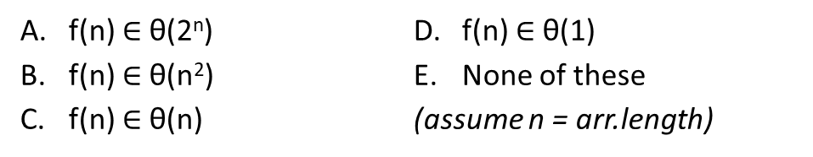
Count how many times each line executes, then say which Θ( ) statement(s) is(are) true.
int sumTheMiddle(int[] arr){
int range = 100;
int start = arr.length/2 – range/2;
int sum = 0;
for (int i=start; i<start+range; i++)
{
sum += arr[i];
}
return max;
}
f(n) $∈$ θ(2^{n})
f(n) $∈$ θ(n²)
f(n) $∈$ θ(n)
f(n) $∈$ θ(1)
None of these
(assume n = arr.length)

Slide 20
Count how many times each line executes, then say which Θ( ) statement(s) is(are) true.
int sumTheMiddle(int[] arr){
int range = arr.length/100;
int start = arr.length/2 – range/2;
int sum = 0;
for (int i=start; start+range; i++)
{
sum += arr[i];
}
return sum;
}
f(n) $∈$ θ(2^{n})
f(n) $∈$ θ(n²)
f(n) $∈$ θ(n)
f(n) $∈$ θ(1)
None of these
(assume n = arr.length)

Slide 21
With worst case analysis, which algorithm has the better (smaller) Big-Θ bound?
boolean find( String[] theList, String toFind ) {
for ( int i = 0; i < theList.length; i++ ) {
if ( theList[i].equals(toFind) )
return true;
}
return false;
}
boolean fastFind( String[] theList, String toFind ) {
return false;
}
find
fastFind
They are the same

Slide 22
With best case analysis, which algorithm has the better Big-Θ bound?
boolean find( String[] theList, String toFind ) {
for ( int i = 0; i < theList.length; i++ ) {
if ( theList[i].equals(toFind) )
return true;
}
return false;
}
boolean fastFind( String[] theList, String toFind ) {
return false;
}
find
fastFind
They are the same

Slide 23
Practical sorting algorithms: Selection sort
Pseudocode: selectionSort
While the size of the unsorted part is greater than 1
find the position of the smallest element in the unsorted part
move this smallest element to the last position in the sorted part
increase the size of the sorted part and decrement the size of the unsorted part
https://www.youtube.com/watch?v=Ns4TPTC8whw
12
4
9
3
15
8
19
2
sorted
unsorted

Slide 24
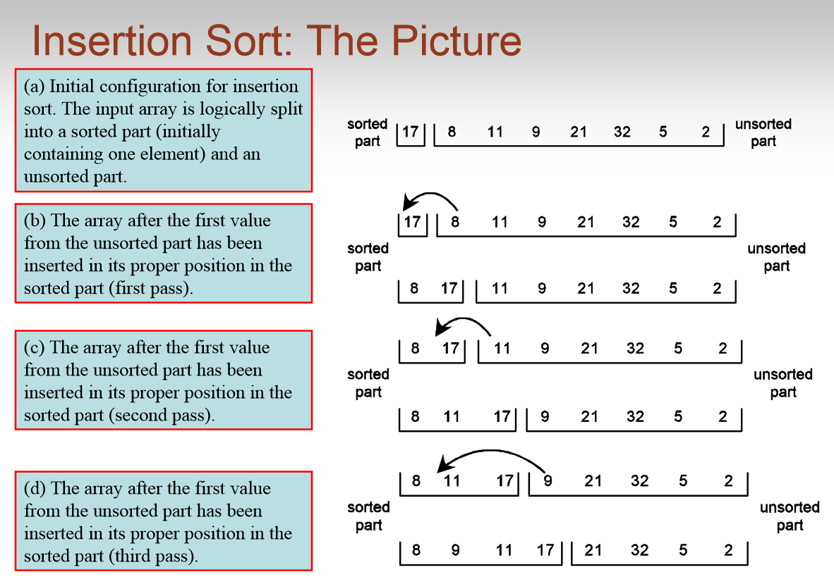
https://www.youtube.com/watch?v=ROalU379l3U

Slide 25
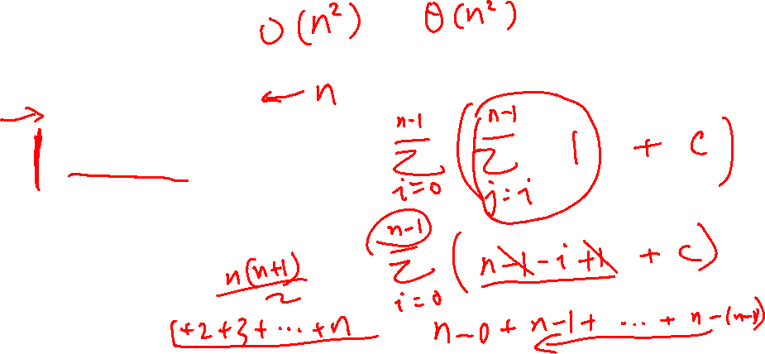
Selection Sort – what does it print out?
import java.util.Arrays;
public class Sort {
public static void sortA(int[] arr) {
for(int i = 0; i < arr.length; i += 1) {
System.out.print(Arrays.toString(arr) + " -> ");
int minIndex = i;
for(int j = i; j < arr.length; j += 1) {
if(arr[minIndex] > arr[j]) { minIndex = j; }
}
int temp = arr[i];
arr[i] = arr[minIndex];
arr[minIndex] = temp;
System.out.println(Arrays.toString(arr));
}
}
}
Sort.sortA(new int[]{ 53, 83, 15, 45, 49 });
[53, 83, 15, 45, 49] ->

Slide 26
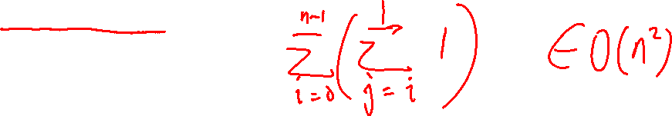
Insertion Sort – what does it print out?
import java.util.Arrays;
public class Sort {
public static void sortB(int[] arr) {
for(int i = 0; i < arr.length; i += 1) {
System.out.print(Arrays.toString(arr) + " -> ");
for(int j = i; j > 0; j -= 1) {
if(arr[j] < arr[j-1]) {
int temp = arr[j-1];
arr[j-1] = arr[j];
arr[j] = temp;
}
}
System.out.println(Arrays.toString(arr));
}
}
}
Sort.sortB(new int[]{ 53, 83, 15, 45, 49 });
[53, 83, 15, 45, 49] ->

